Slide 1
XM125 Test
Taehun Kim
bigteach0508@pusan.ac.kr
Embedded Systems Lab.
School of AI, PNU
2025. 03. 12

Slide 2
Contents
Schematic
Installation
GUI results
CLI installation
CLI results
Conclusion

Slide 3
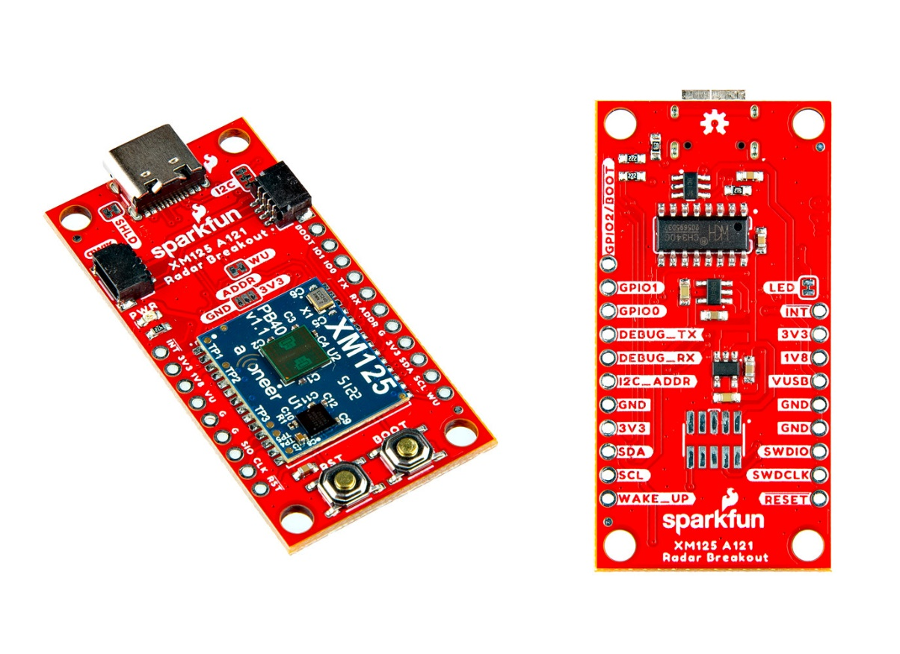
Schematic
Sparkfun XM125
CH340
Serial-to-USB
A121
MCU
Figure 1. Sparkfun XM125

Slide 4
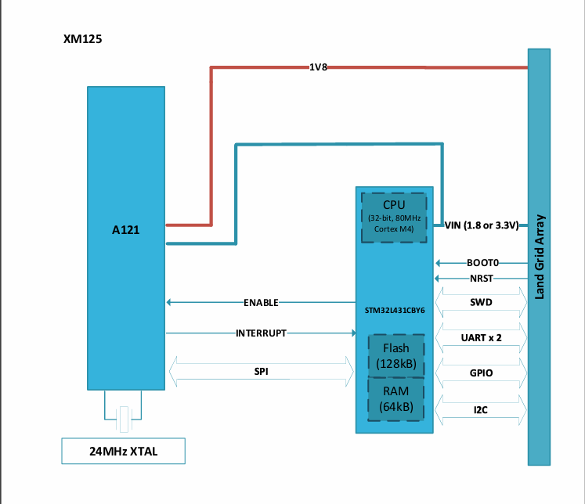
Schematic (cont’d)
XM125 block diagram
Figure 2. XM125 block diagram

Slide 5
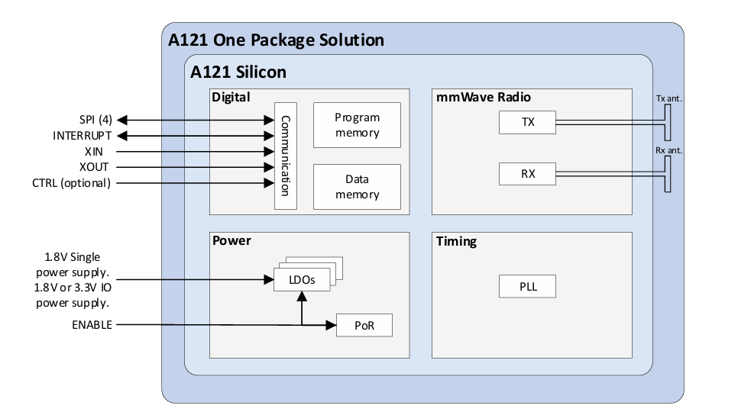
Schematic (cont’d)
A121
1 Tx antenna and 1 Rx antenna
Serial Peripheral Interface(SPI) communication with MCU
Figure 3. A121 block diagram

Slide 6
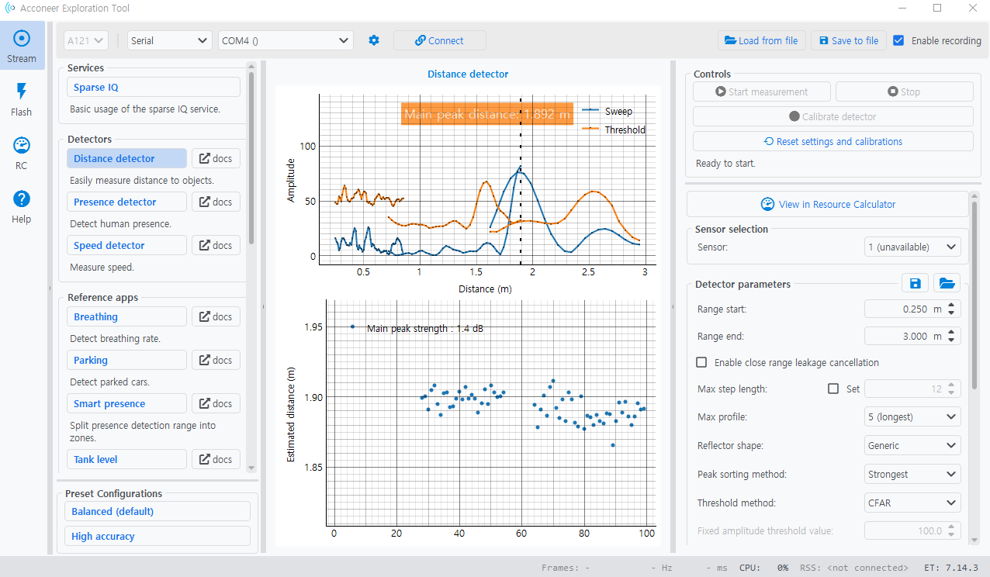
Installation
Install CH340 driver
https://www.arduined.eu/ch340-windows-10-driver-download/
Download Acconeer Exploration Tool
https://developer.acconeer.com/download/portable_exploration_tool/
Double click the update.bat file and the run_app.bat
Figure 4. Acconeer Exploration Tool

Slide 7
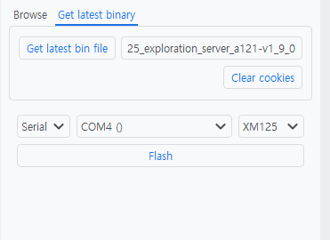
Installation (cont’d)
Flashing firmware
Click the flash menu
Click Get latest binary – Get latest bin file
Register at https://developer.acconeer.com/register/
Download the firmware
Click the flash button to flashing firmware
Figure 5. Download the firmware

Slide 8
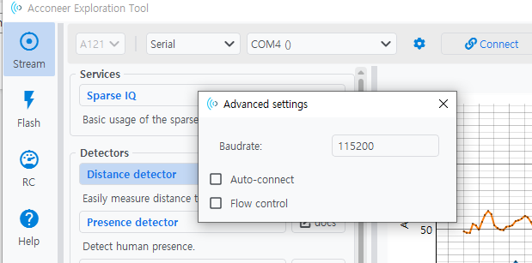
Installation (cont’d)
Baud rate setting
Click the setting(cogwheel) button
Setting the baudrate to 115200
Figure 6. Setting the baudrate

Slide 9
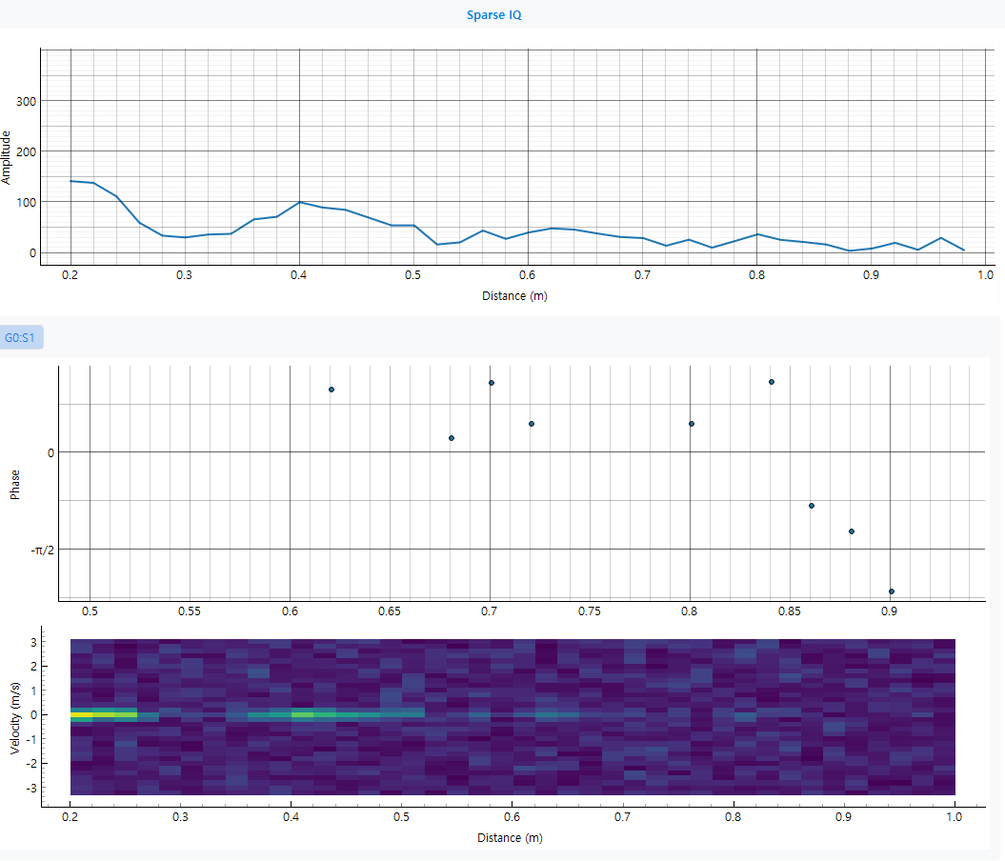
GUI results
Sparse IQ
Figure 7. Sparse IQ

Slide 10
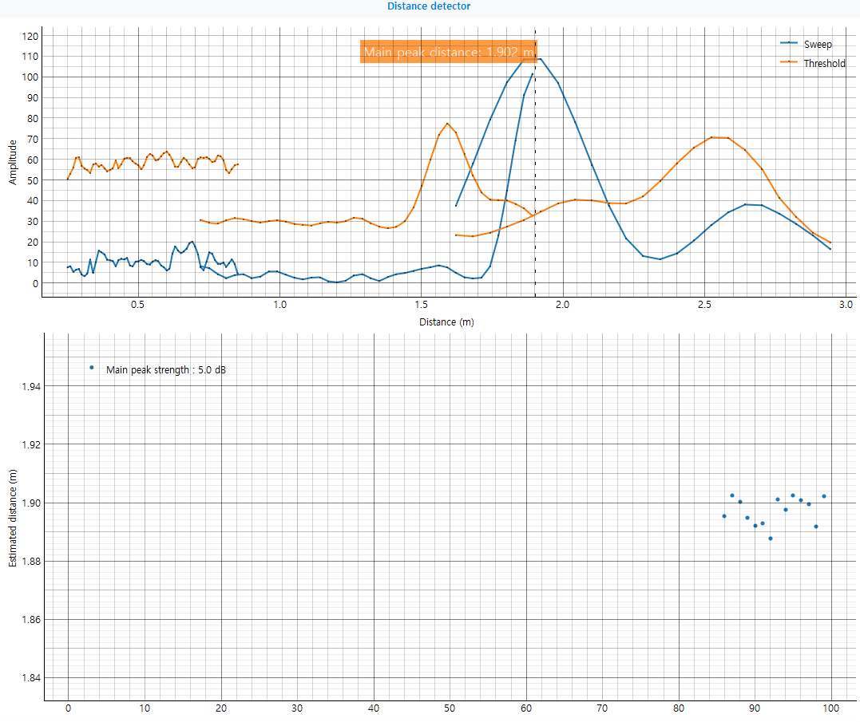
GUI results (cont’d)
Distance detector
Figure 8. Distance detector

Slide 11
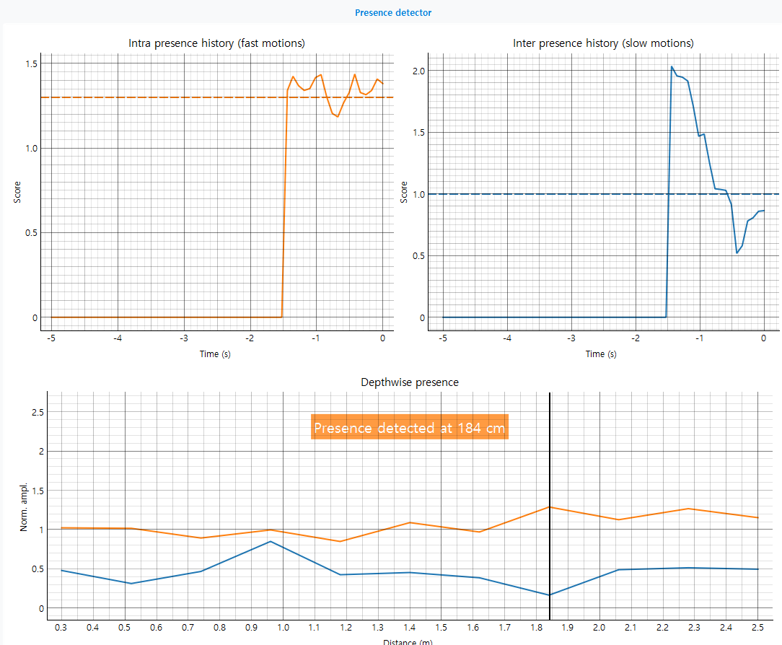
GUI results (cont’d)
Presence detector
Figure 9. Presence detector

Slide 12
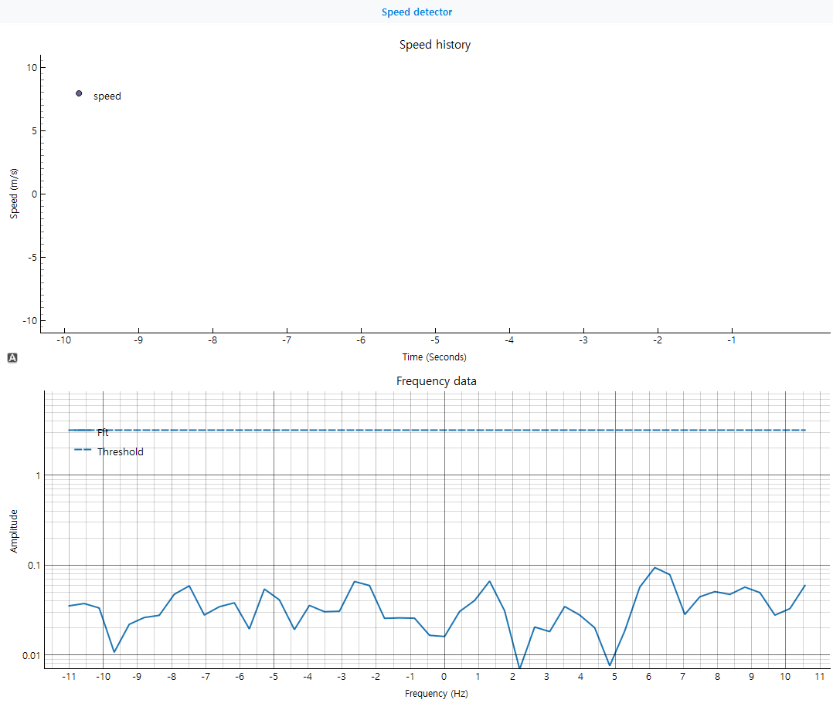
GUI results (cont’d)
Speed detector
Figure 10. Speed detector

Slide 13
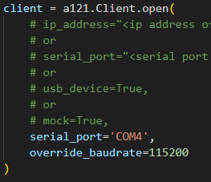
CLI installation
Get example source code
https://github.com/acconeer/acconeer-python-exploration/tree/master/examples
Double click the cmd_with_path.bat in portable_exploration_tool
Set client information
Serial port and baudrate
Run the source code
python examples/a121/basic.py
Figure 11. Serial Configuration

Slide 14
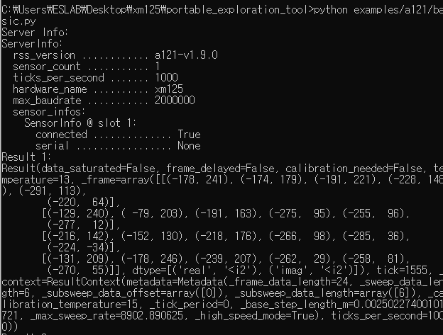
CLI results
Basic.py
print real parts and imaginary parts of the receive signals
Sweep_per_frame x num_points
Figure 12. Real and imaginary part of signals

Slide 15
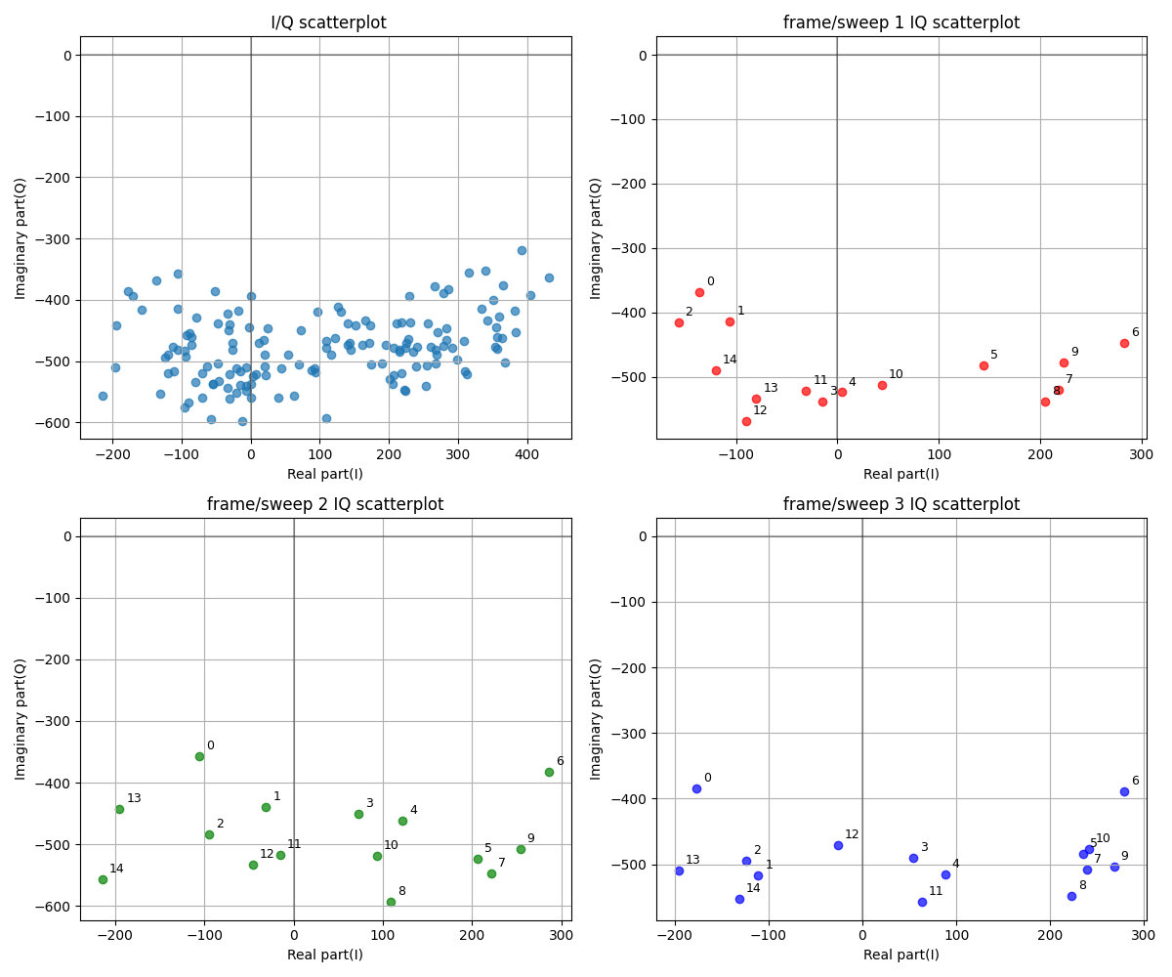
CLI results
basic_plot.py
Figure 13. I/Q scatterplot

Slide 16
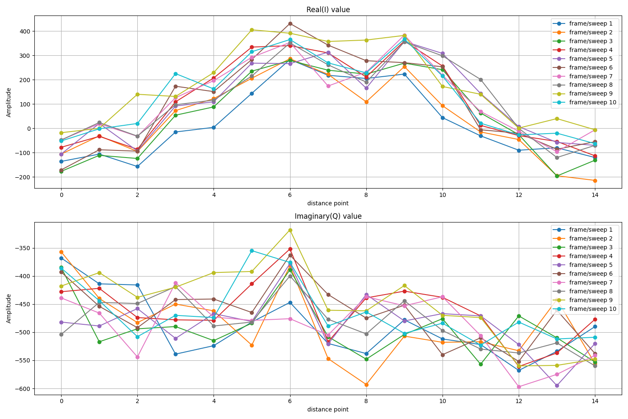
CLI results (cont’d)
basic_plot.py
Figure 14. real and imaginary value by sweep and distance point

Slide 17
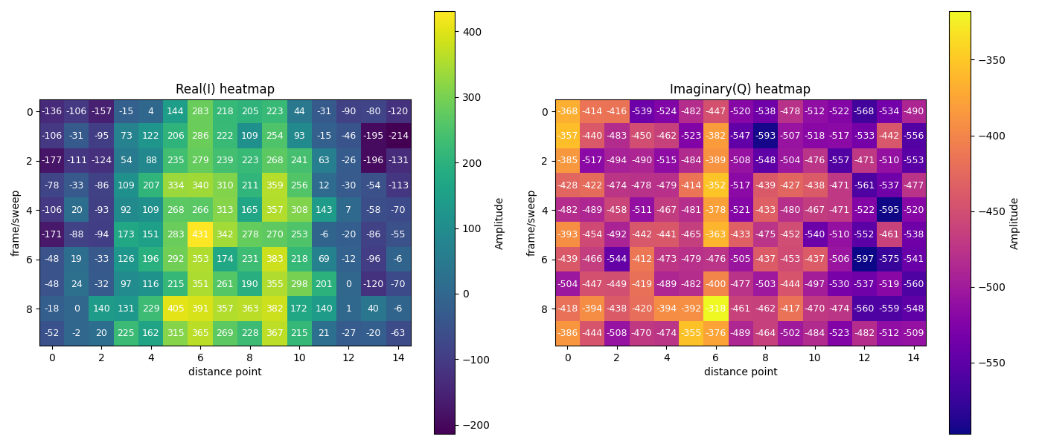
CLI results (cont’d)
Basic_plot.py
Figure 15. real and imaginary heatmap by sweep and distance point

Slide 18
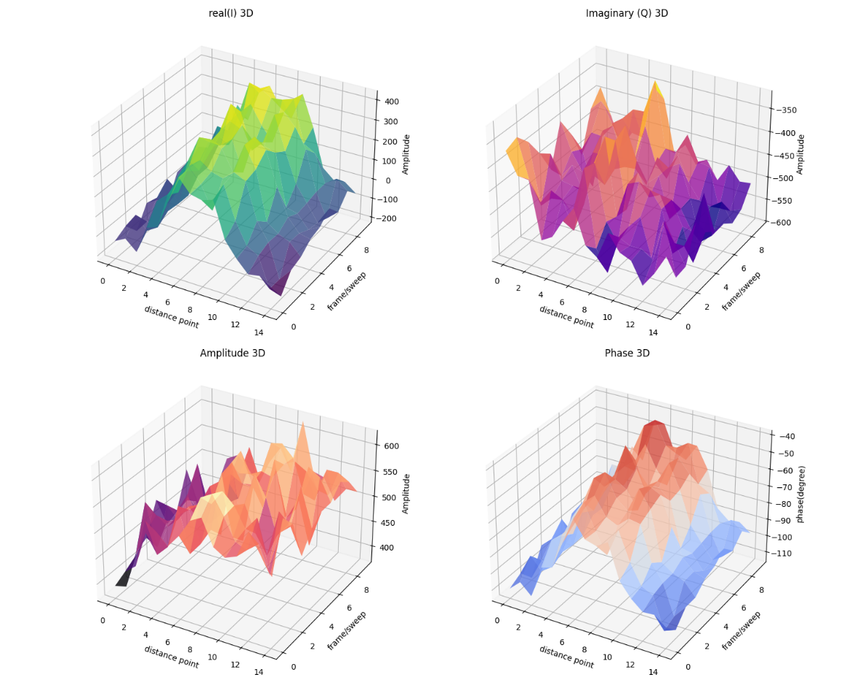

CLI results (cont’d)
Basic_plot.py
$Amp=\sqrt{I^{2}+Q^{2}}, Phase=\arctan{\frac{Q}{I}}$
Figure 16. real, imaginary, amplitude, phase heatmap by sweep and distance point

Slide 19
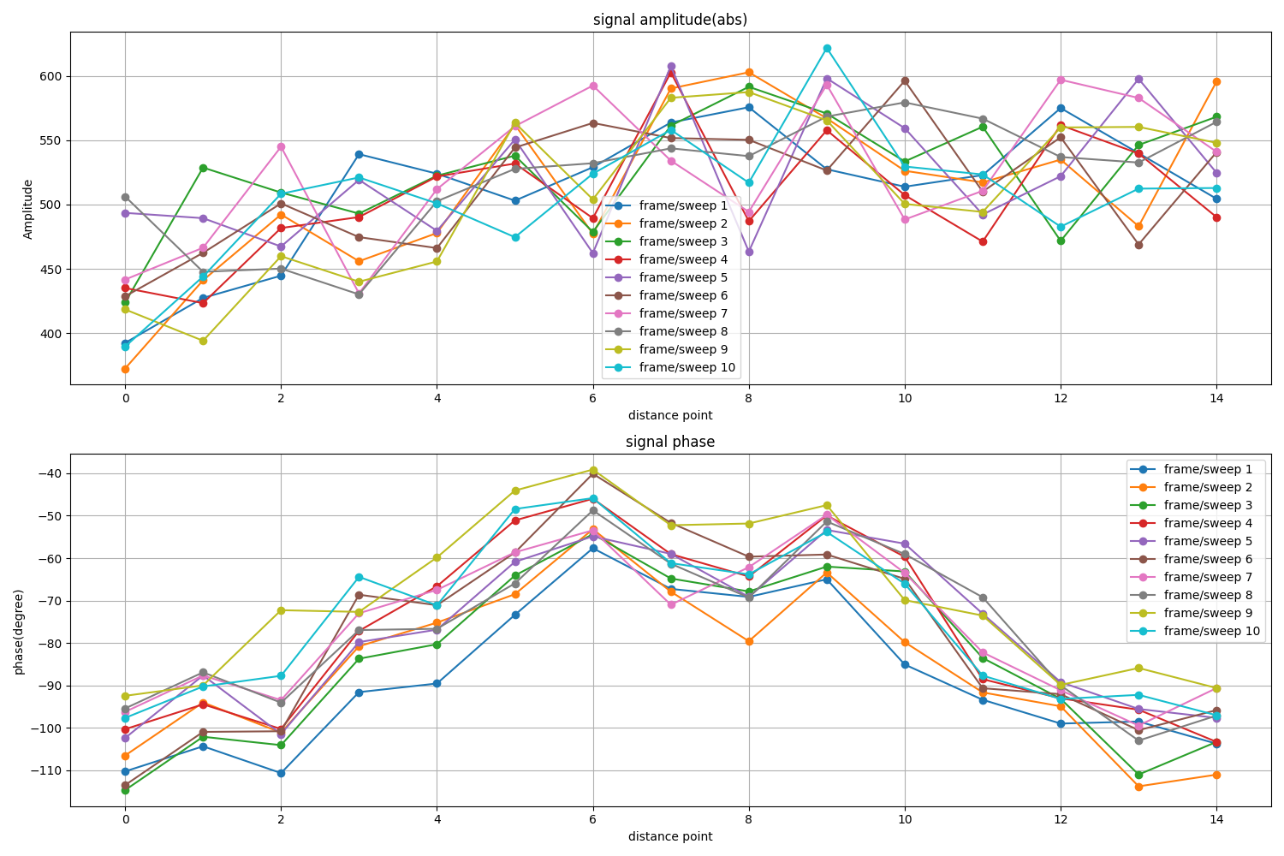
CLI results (cont’d)
basic_plot.py
Figure 17. Amplitude and phase value by frame and distance point

Slide 20
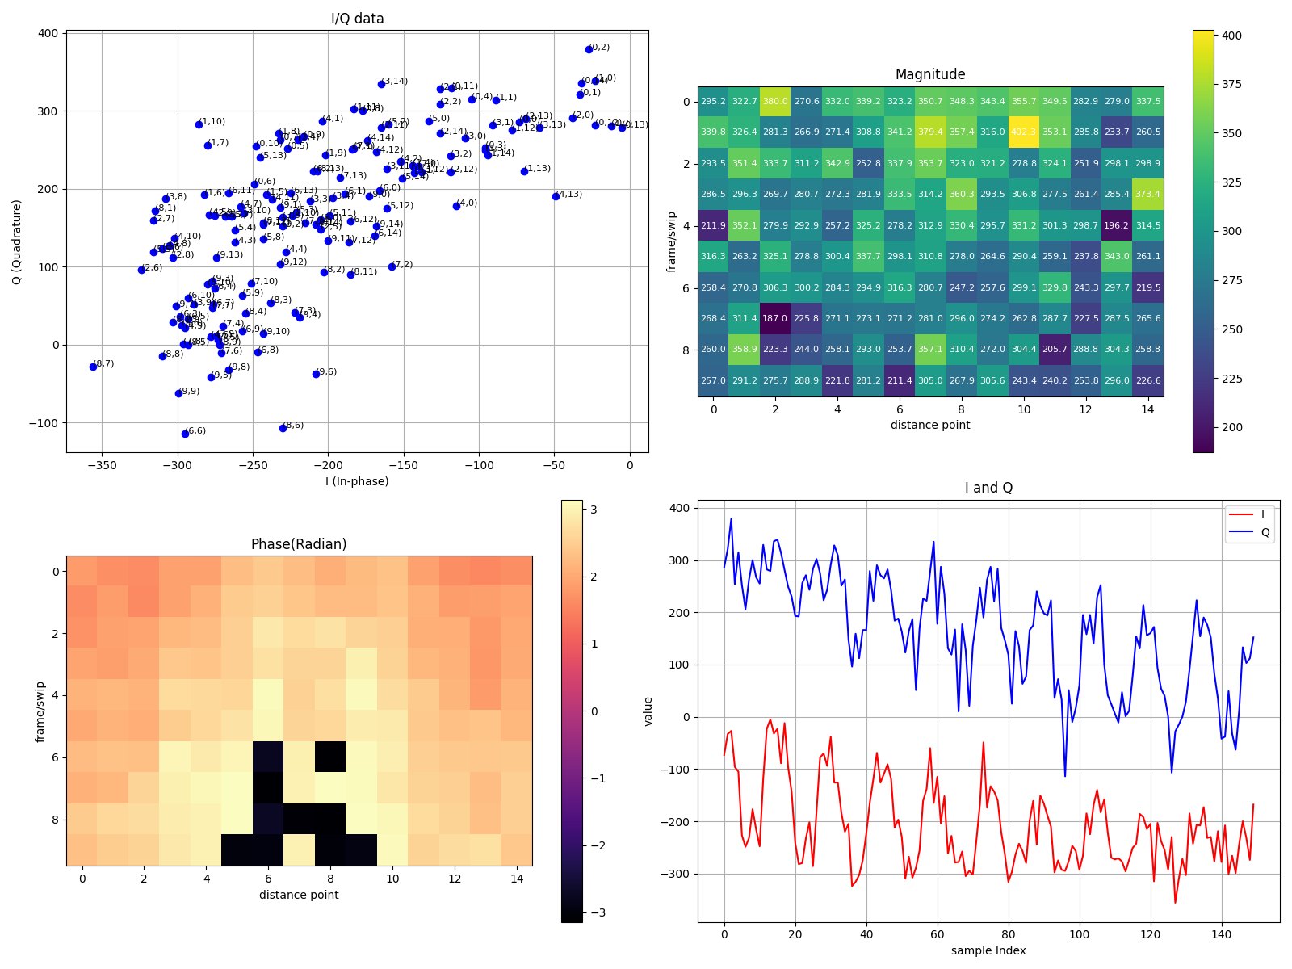
CLI results (cont’d)
Plot_analog.py
Figure 18. plot I/Q data, magnitude heatmap, phase heatmap, and I Q line plot

Slide 21
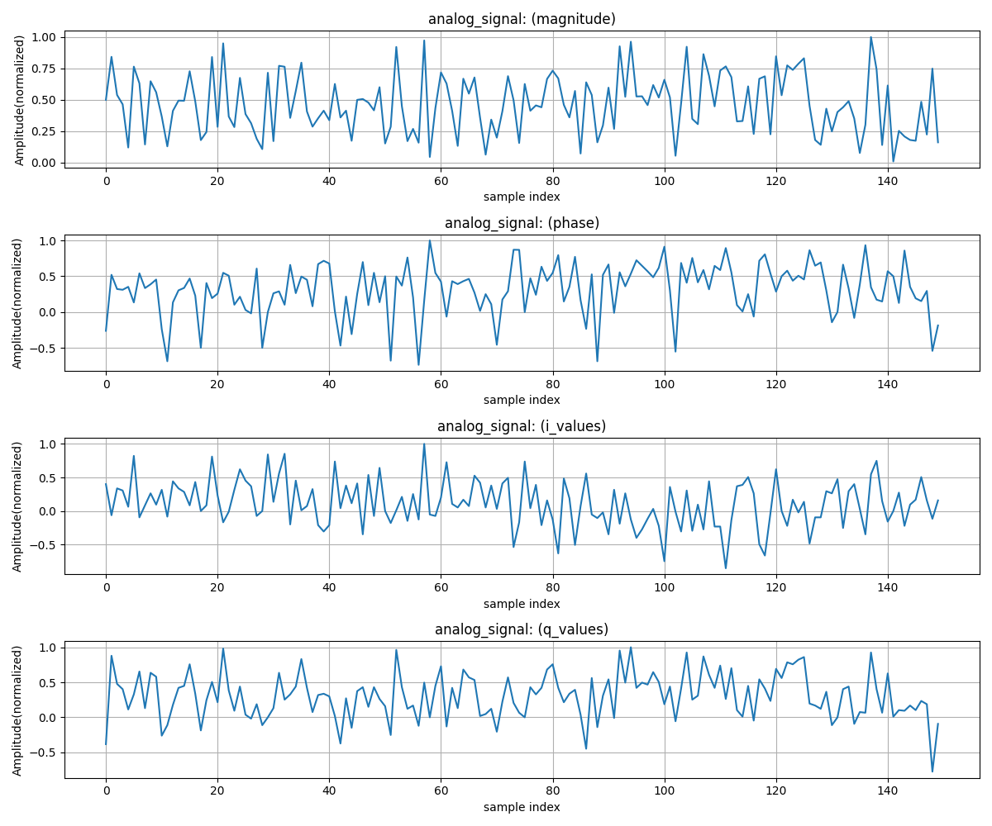
CLI results (cont’d)
Plot_analog.py
Figure 19. plot magnitude, phase, i_values, q_values after flattening signal

Slide 22
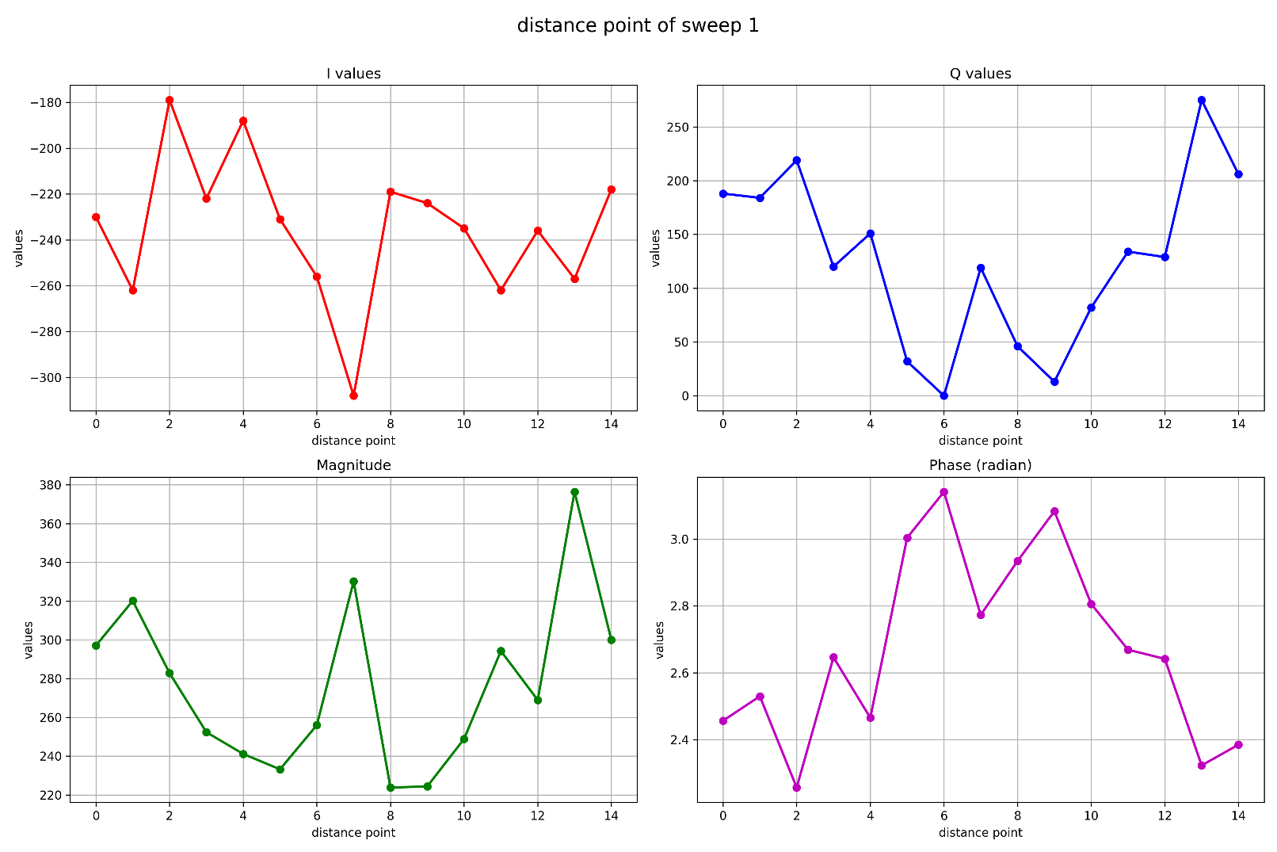
CLI results (cont’d)
plot_analog2.py
Figure 20. Distance point of sweep 1

Slide 23
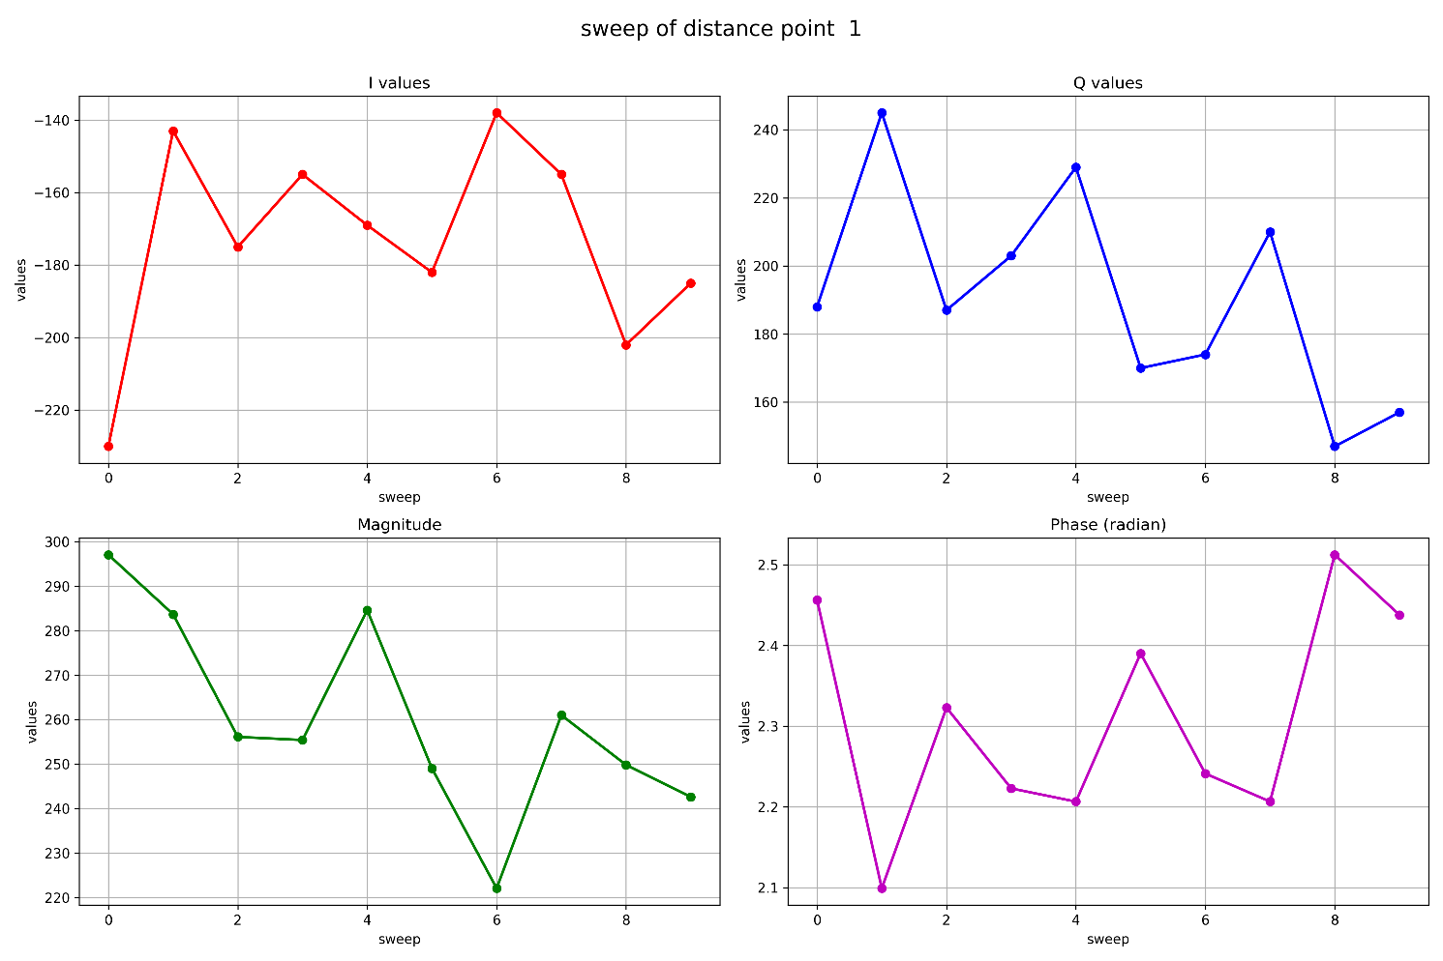
CLI results (cont’d)
plot_analog2.py
Figure 21. Sweep of distance 1

Slide 24
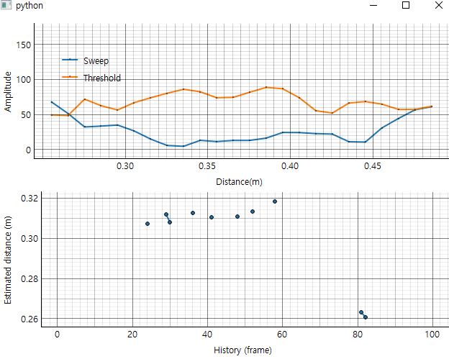
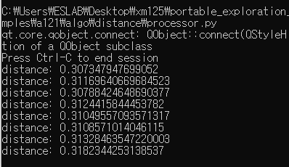
CLI results (cont’d)
Distance measurement
Modify examples/a121/algo/distance/processor.py
Figure 22. Distance measurement

Slide 25
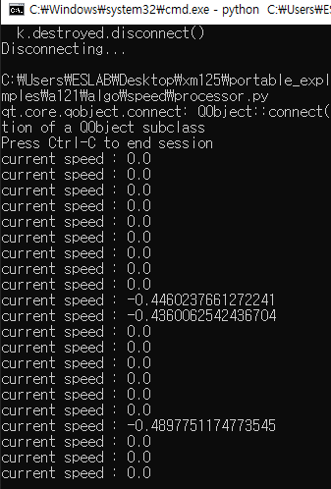
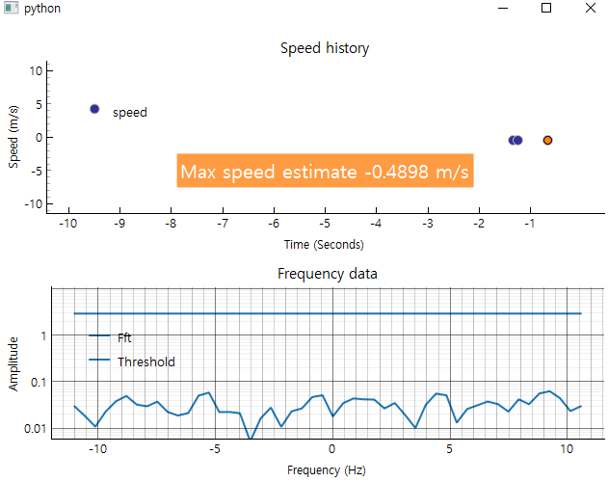
CLI results (cont’d)
Speed measurement
Modify examples/a121/algo/speed/processor.py
Figure 23. Speed measurement

Slide 26
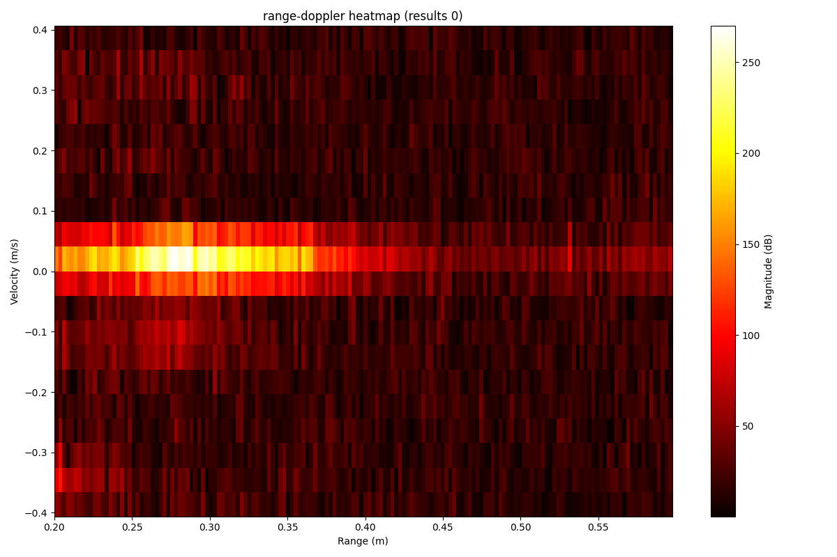
CLI results (cont’d)
Sparse IQ
Modify example/a121/algo/sparse_iq/sparse_iq.py
Range-doppler heatmap
Range: from start_point*0.0025 to start_point*step_size*num_points
Step_size = step_length*0.0025
Velocity: +- wavelength/(4*sweep_period)
Sweep_period=1.0/sweep_rate
Step_size=sweeps_per_frame
Figure 24. Range-doppler heatmap of result 0

Slide 27
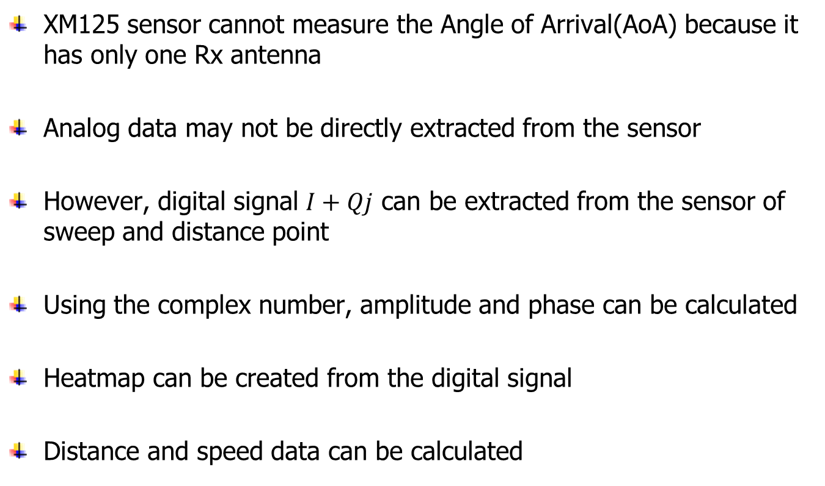
Conclusion
XM125 sensor cannot measure the Angle of Arrival(AoA) because it has only one Rx antenna
Analog data may not be directly extracted from the sensor
However, digital signal $I+Qj$ can be extracted from the sensor of sweep and distance point
Using the complex number, amplitude and phase can be calculated
Heatmap can be created from the digital signal
Distance and speed data can be calculated

Slide 28
References
Manual
XM125 datasheet
XM125 schematic
Online
https://github.com/acconeer/acconeer-python-exploration
https://docs.acconeer.com/en/latest/exploration_tool/api/a121.html
https://matplotlib.org/stable/users/index.html
https://matplotlib.org/stable/gallery/mplot3d/index.html

Slide 29
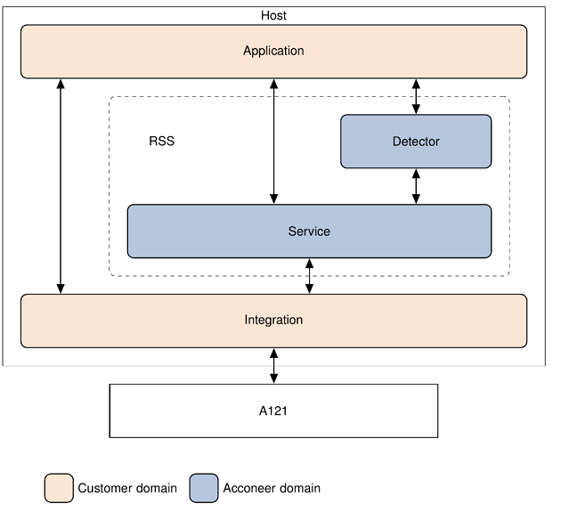
Appendix
Acconeer software offers
Service output is radar data with some pre-processing
Detector output is based on service output but uses further processing to create a result such as a distance or presence detection
Figure 25. Acconeer software offers

Slide 30
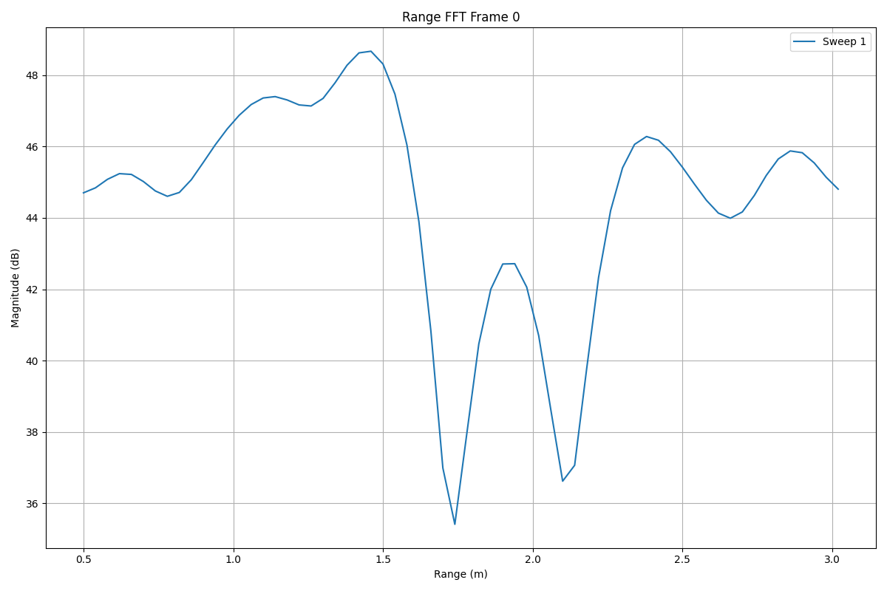
Appendix (cont’d)
Custom Range FFT
Figure 26. Range FFT

Slide 31
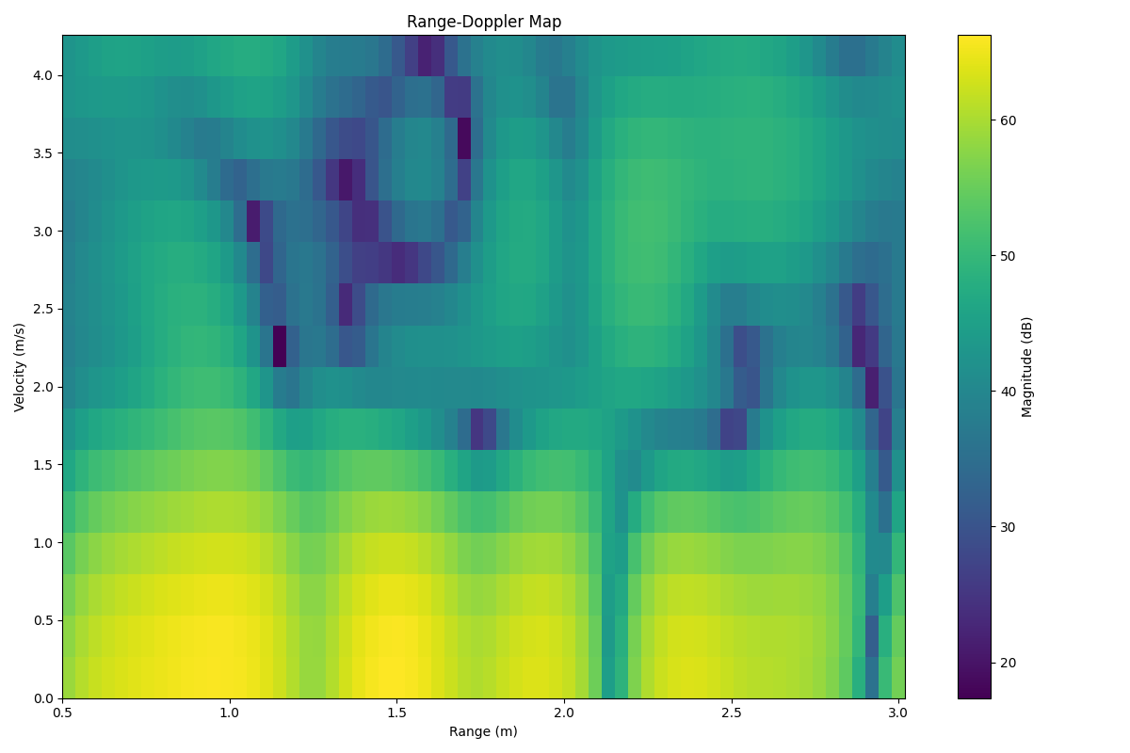
Appendix (cont’d)
Custom range-doppler heatmap
Figure 27. Range-Doppler FFT heatmap

